Slide 1
THINGS THAT STILL NEED FIXING
DATE ON TITLE SLIDE
Subtitle for new wrinkles due to shaping
BD slide (keep?) better word for unsorted fluctuations than bulk

Slide 2

Investigation of MHD mode Structure in Shaped HBT-EP Plasmas
Patrick Byrne
Thesis Proposal Presentation
Date TBD

Slide 3
Outline
Introduction
Motivation for Shaped Plasma Research on HBT-EP
HBT-EP Baseline and New Capabilities
Analysis Procedures
New Challenges
Plasma/Sensor coupling
Positional Instability
Proposed Research Plan
Observe structure and dynamics of RWM in shaped Plasmas
Natural structure/growth rates
RMP Response
Initial Results
Summary

Slide 4
Outline
Introduction
Motivation for Shaped Plasma Research on HBT-EP
HBT-EP Baseline and New Capabilities
Analysis Procedures
New Challenges
Plasma/Sensor coupling
Positional Instability
Proposed Research Plan
Observe structure and dynamics of RWM in shaped Plasmas
Natural structure/growth rates
RMP Response
Initial Results
Summary

Slide 5
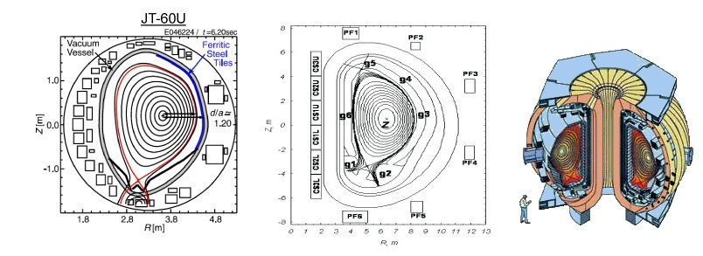
Introduction - Motivation
Any fusion plasma will need to be shaped
Fusion plasma heat load too high for material limiter
Exhaust redirected to diverter protects instruments, VV wall
Shaping allows access to higher β regimes, easier access to H-Mode
All present and planned advanced tokamaks are non-circular
Notes:
Shaping has been shown or predicted to reduce severity of many plasma instabilities (ELMs, ITG, Sawteeth)

Slide 6
Introduction - Motivation
Any fusion plasma will need to be shaped
HBT-EP’s Mission (in part):
To quantify external kink dynamics and multimode response to applied magnetic perturbations… in ways that are ITER and reactor relevant^{[1]}
Kink instabilities potentially limit performance in fusion reactors
HBT-EP is well instrumented to measure external kink modes
Shaping HBT-EP’s plasmas increases relevancy of kink studies to fusion reactors

Slide 7
Introduction – HBT-EP Capabilities
High resolution magnetic sensors
216 total sensors, in 3 arrays, measuring radial and poloidal field
Highly modular passively stabilizing shells
2 independently positionable sets of 10 stainless steel/SS+ferritic walls
Active control coils
2 coils per shell (of 6) can be independently driven for RMP or feedback

Slide 8
Introduction – HBT-EP Capabilities
Zero-net-turns shaping coil
Installed above inboard midplane
Center bundle of 4 turns;
Flanked by 2 bundles of 2
All bundles connected in series
Max current: 7.5 kA / turn
Center bundle current: 2*I_{p}
Arbitrary current/polarity
Allows variety of shapes
Fast startup, sustained current
t_{start} < 1ms
t_{peak} > 7ms
Notes:
Peak defined as I_{sh} greater than 90% peak I_{sh}

Slide 9
Introduction – Analysis procedures
Plasma equilibria solved using TokaMac
Equilibria ideal stability modeled in DCON (edge = Ψ_{99.5})
Predicted sensor pickup modeled using VALEN
Actual mode measurements filtered by biorthogonal decomposition

Slide 10
Introduction – Analysis Procedures Biorthogonal Decomposition
Biorthogonal Decomposition used to resolve coherent modes from bulk? Fluctuations
Mathematically equivalent to singular value decomposition of matrix with columns composed of individual sensor traces
Insensitive to errors in sensor positioning or orientation
Requires no a priori assumption of mode basis
Allows discrimination of modes with power ~1% of total fluctuations

Slide 11
New Challenges
Vacuum fields designed for centered, circular plasma
Shaping displaces plasma upwards, and makes vacuum fields positionally destabilizing
Theory^{[2]} predicts passive
stabilization of plasma position
Growth time reduced to
scale longer than plasma
lifetime

Slide 12
New Challenges
Vacuum fields designed for centered, circular plasma
Shaping displaces plasma upwards, and makes vacuum fields positionally destabilizing
Theory^{[2]} predicts passive
stabilization of plasma position
Growth time reduced to
scale longer than plasma
lifetime

Slide 13
New Challenges
Sensor arrays designed for centered, circular plasma,
as are control coils
Coupling to plasma/mode will vary poloidally.
VALEN can be used to predict coupling at each sensor/coil
Allows us to more accurately measure plasma modes
Allows us to maximize resonant field vs control coil current
Novel method, can be applied to circular plasmas as well

Slide 14
Proposed Research
Explore structure and dynamics of RWMs in shaped geometry
Shape and growth rates of natural modes
Effect of passive stabilization
Response to resonant magnetic perturbations (RMP)

Slide 15
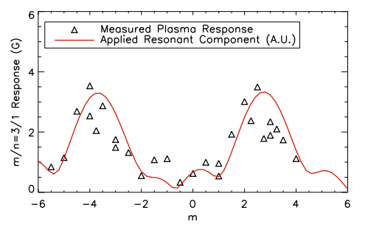
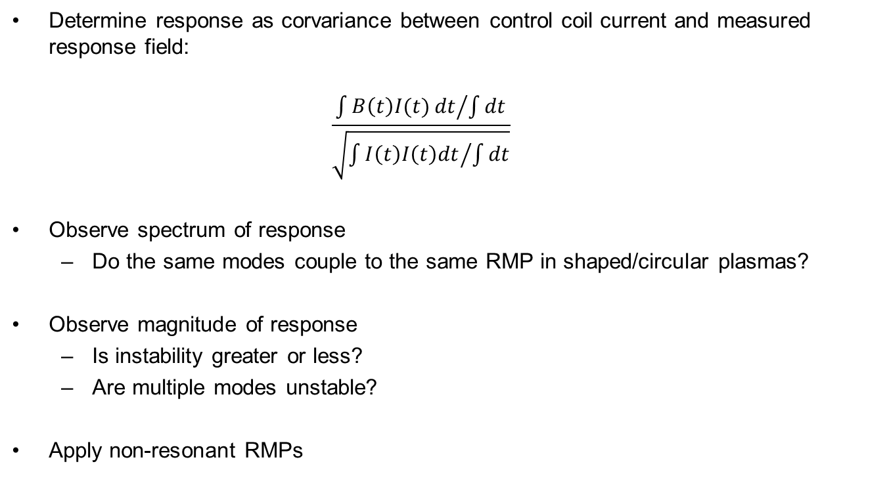
Proposed Research - RMPs
Determine response as corvariance between control coil current and measured response field:
$$\frac{{\int{B\left(t\right)I(t)}dt}/{\int{dt}}}{\sqrt{{\int{I\left(t\right)I\left(t\right)dt}}/{\int{dt}}}}$$
Observe spectrum of response
Do the same modes couple to the same RMP in shaped/circular plasmas?
Observe magnitude of response
Is instability greater or less?
Are multiple modes unstable?
Apply non-resonant RMPs

Slide 16
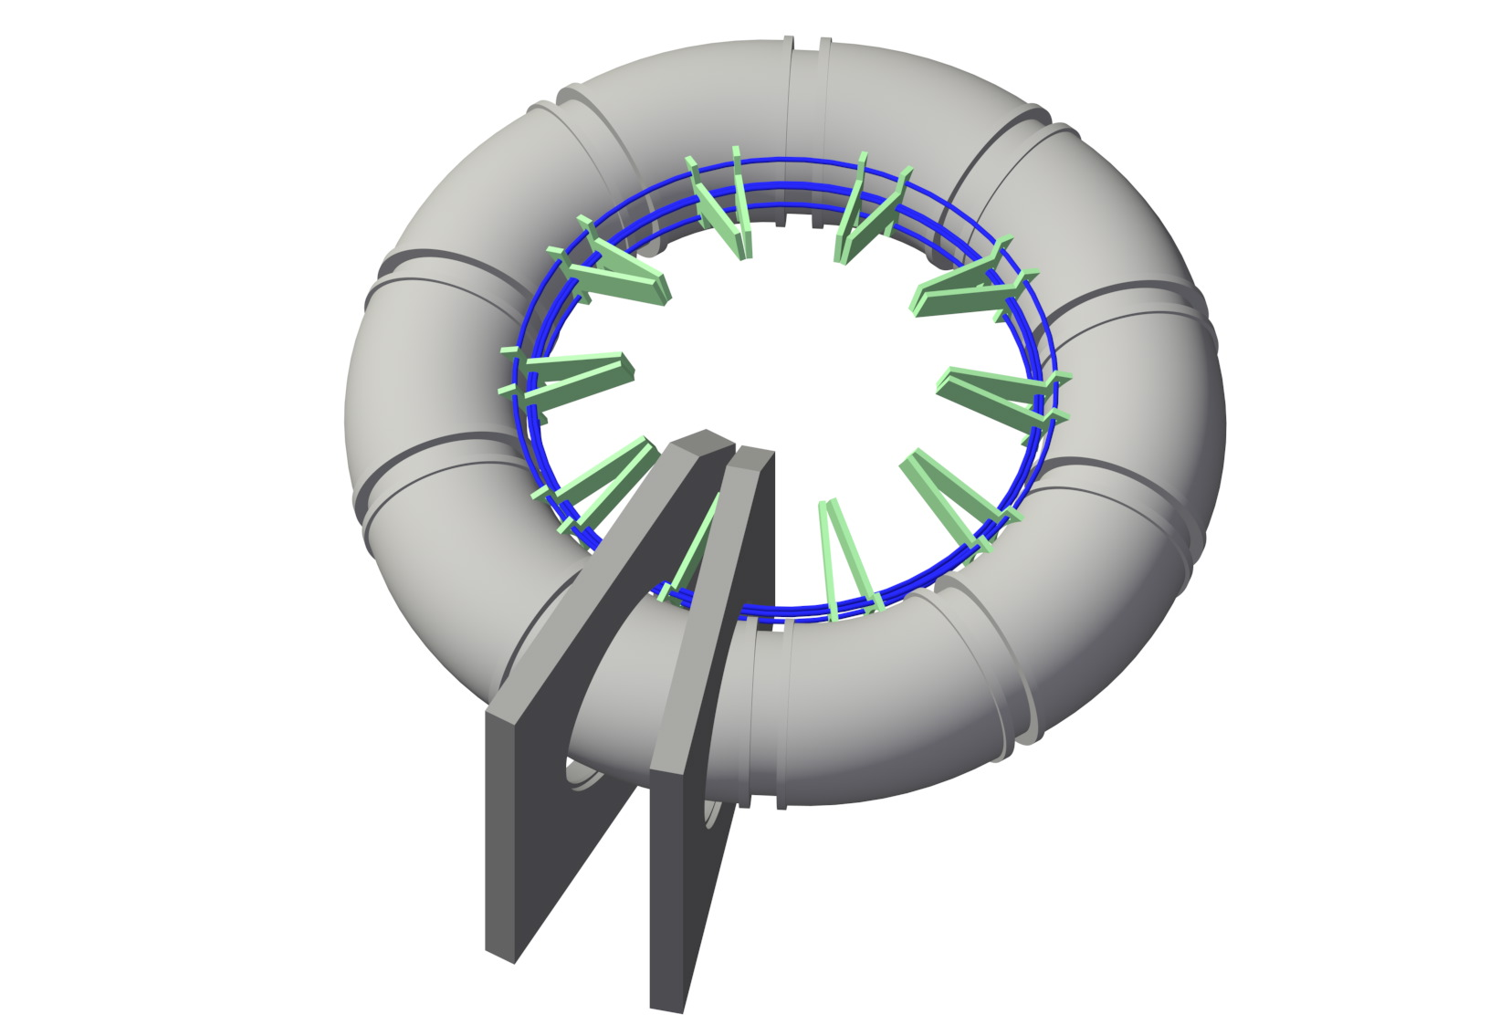
The HBTEP Shaping Coil
Three serially connected cable loops
Edge bundles counterwound
from the central cable bundle
Central bundle has twice the number of windings for zero net turns.
Very low coupling at long distances
Minimal interaction with other magnetics, L ~10-20µH

Slide 17
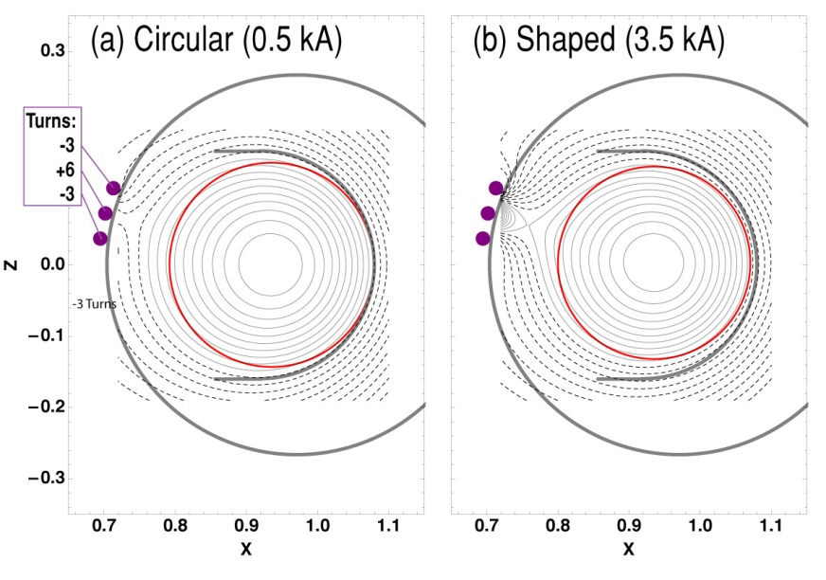
Placement and Construction
The coil will be wound around the high-field side of HBTEP at an angle of ~25 degrees above the high field side midplane.
This setup will allow the creation of local edge effects, while leaving the bulk plasma unperturbed
Fig. 1 – Flux surfaces for a weakly and fully shaped plasma. The red circle represents the last closed flux surface of an unshaped plasma

Slide 18
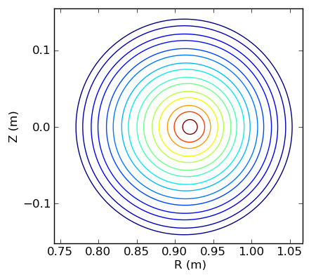
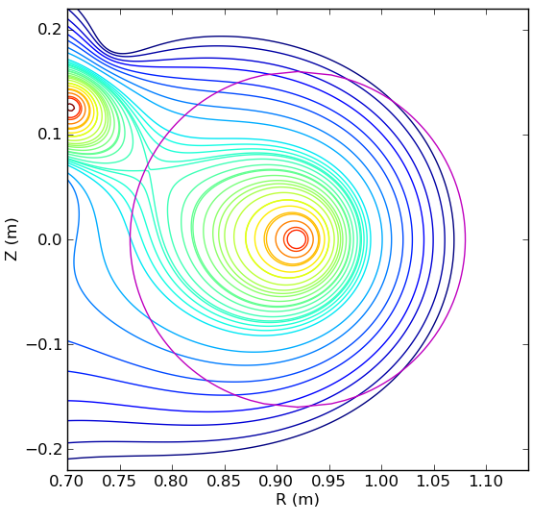
Simulations Show Diversion is Possible
15º separation between coils
Coil current ~11kA (15kA max)

Slide 19
Outline
Magnetic Geometry
The HBTEP Shaping Coil
Control Coil Shaping
Summary

Slide 20
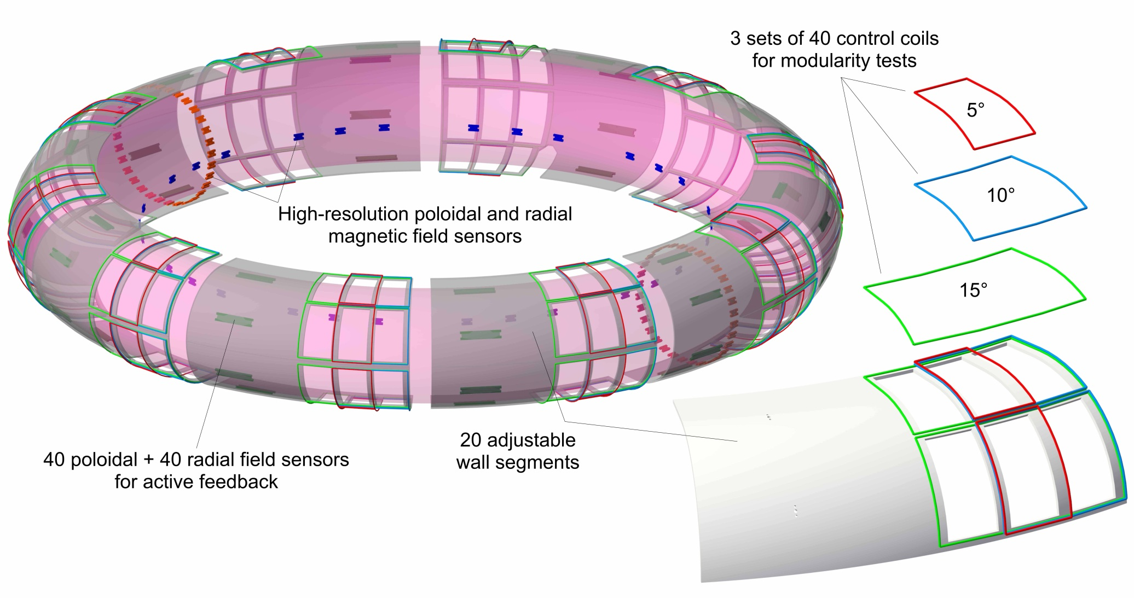
HBTEP Can Already Magnetically Influence The Plasma
120 Feedback coils (3 sets of 40)

Slide 21
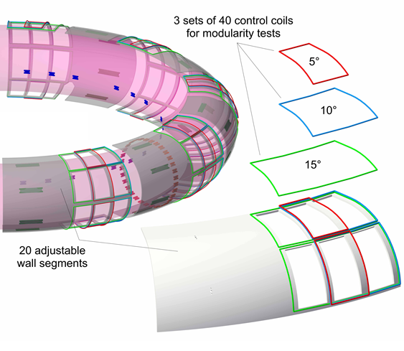
HBT Control Coils
120 Feedback coils (3 sets of 40)
Can apply wide spectrum of magnetic perturbations
Can be used to excite or suppress magnetic modes, or affect the shape of magnetic surfaces

Slide 22
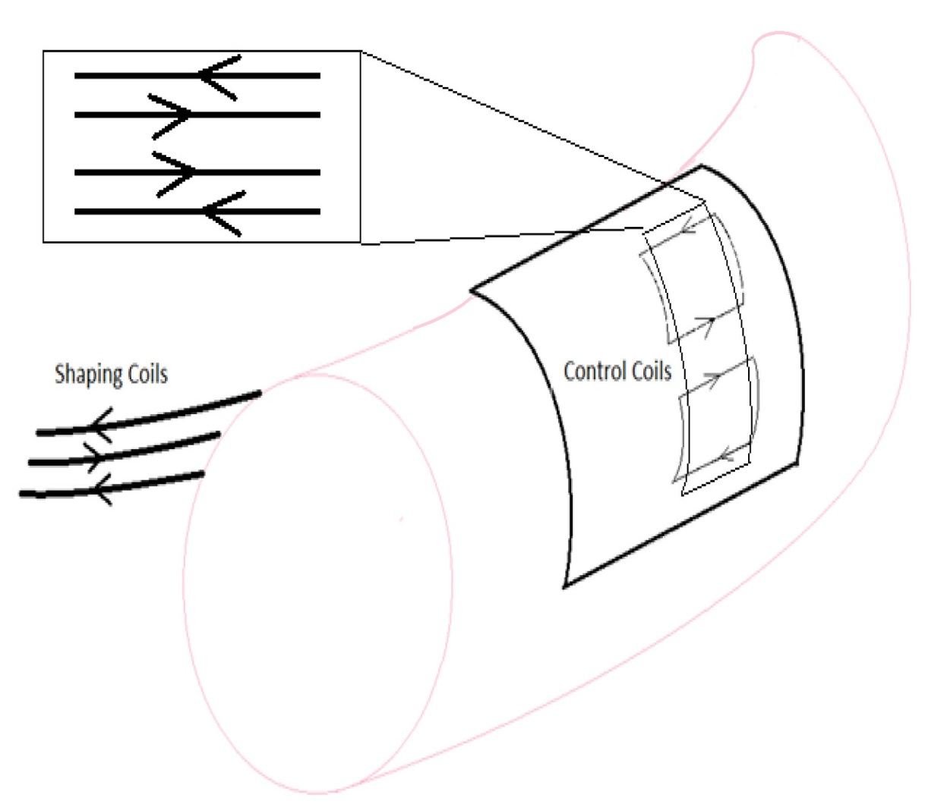
Shaping Coil / Control Coil Substitution
Large control coils cover 15º toroidal angle.
If fired with equal but opposite currents, nearby fields look similar to shaping coil
Discrete approximation to shaping coil

Slide 23
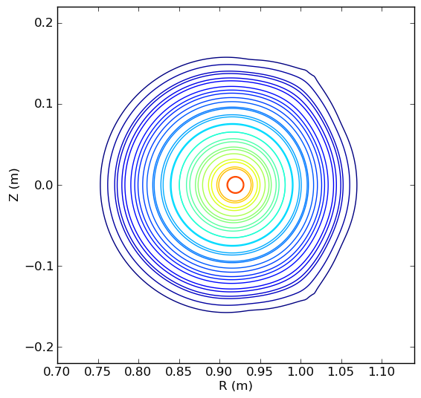
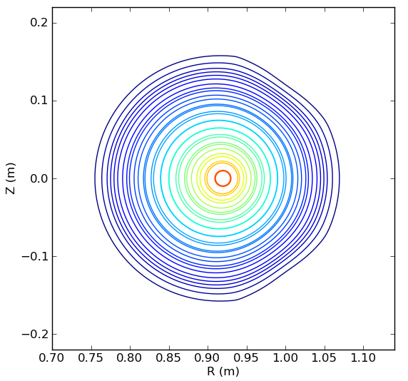
Control Coil Shaped plasmas

Slide 24
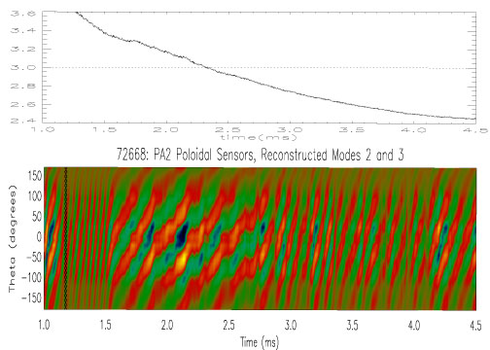
Unshaped n=1, m=3 mode activity

Slide 25
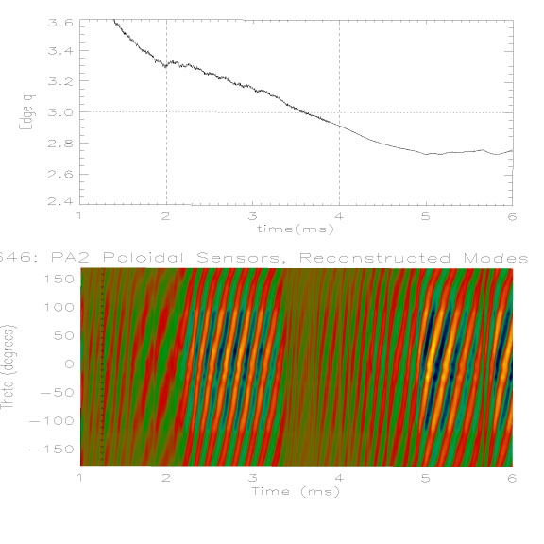
“Triangle” shaped n=1, m=3 mode activity

Slide 26
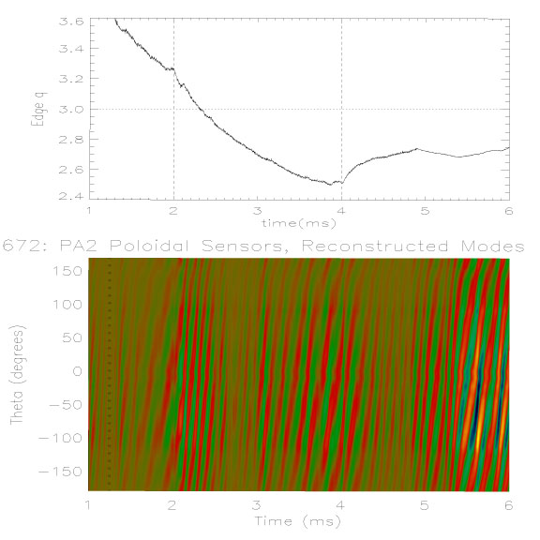
“Square” shaped n=1, m=3 mode activity

Slide 27
Summary
Fusion-relevant plasma experiments (ITER,DEMO) will have non-circular cross-section
The shaping coil will allow us to gain insight into multimode instabilities in the presence of shaping.
Degree of shaping arbitrary, including diverted operation
Experiments have indicated significant effects for a minor degree of plasma shaping

Slide 28
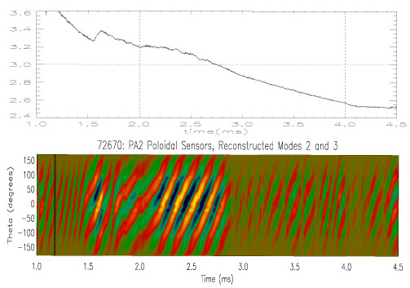

Slide 29
